Slide 1
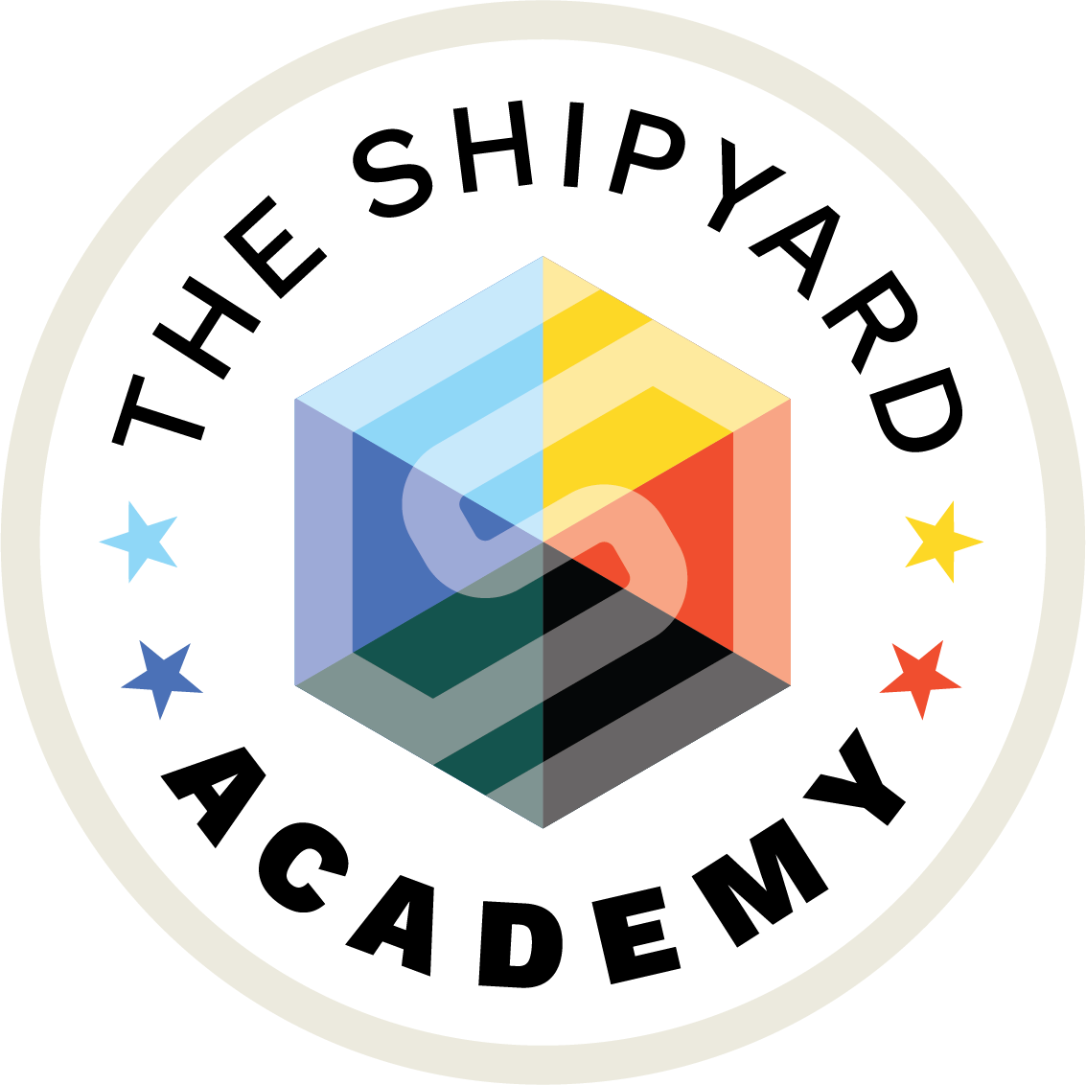
GEO
FEBRUARY 2026
HOW AI IS RESHAPING SEARCH STRATEGY

Slide 2
SESSION AGENDA
How AI Is Reshaping Search Strategy | 60 Minutes
15 min
The Landscape
AI Topics not covered:
Gen-AI content creation of content, imagery and video
Accuracy and validity of AI
Ethical questions (copyright, misinformation, etc.)
Why this AI evolution matters for our industry and clients specific to search
10 min
The Shipyard’s Approach
Key insights and how we view GEO/AIO to date
15 min
Putting It Into Practice
Tools, audit capabilities, and client case study
20 min
Next Steps
Client opportunities and how to engage

Slide 3
LEARNING OBJECTIVES
By the end of this session, you will be able to:
1
Explain how AI-powered search has fundamentally changed consumer discovery behavior
2
Articulate how it has affected our clients’ business and what it means to our work
3
Describe The Shipyard’s approach to Generative Engine Optimization (GEO)
4
Identify clients who would benefit from an AI Visibility Audit

Slide 4
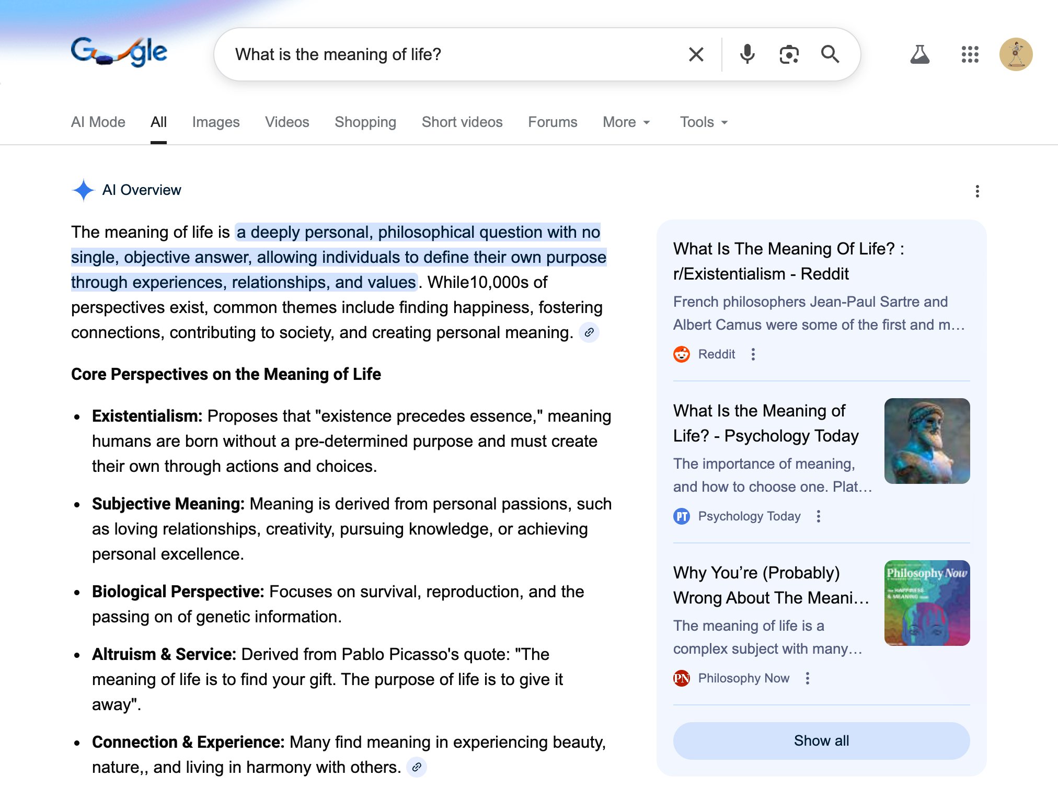
“AI SEARCH” — WHAT DO WE MEAN?
HOW AI IS RESHAPING SEARCH STRATEGY
Key Terminology
AI Overviews
Search engines (Google, Bing, etc.) now provide an overview generated by AI, not just links.
AI Models / LLMs (Large Language Models)
Separate website, chatbot or app
ChatGPT, Gemini, Perplexity, Claude, Copilot, Grok, etc.
GEO (Generative Engine Optimization)
Unlike SEO, GEO deals on brand visibility ‘inside’ generative-AI responses, not keyword rankings.

Slide 5
QUICK POLL
Notes:
1. Are you using Large Language Models (LLMs, like ChatGPT) for search in place of traditional Google searches? (Single choice)
Yes — frequently
Yes — occasionally
Not yet, but I'm interested
No — I don't use LLMs for search
2. Have you heard clients inquiring about this activity and its relevance to their business? (Single choice)
Yes — clients are actively asking about it
Somewhat — it's come up in conversation
Not yet — but I'm expecting it soon
No — it hasn't come up

Slide 6
WHAT’S CHANGED

Slide 7
AI IS REWRITING SEARCH AT INTERNET SPEED
HOW AI IS RESHAPING SEARCH STRATEGY
Four milestones that show why playbooks expire fast
ChatGPT hits 800M weekly active users
ChatGPT begins testing ads
ChatGPT launches publicly
AI Overviews scale globally
Answer-first UX goes mainstream, expectations for “search” shift overnight.
Google expands to 100+ countries, reaching 1B+ monthly users.
Consumer adoption reaches internet-scale, reshaping discovery habits.
Sponsored placements launch for Free/Go users, signaling AI search is moving toward paid distribution and “sponsored answers” alongside organic results
Nov 30, 2022
Oct 28, 2024
Oct 6, 2025
Jan 16, 2026
Notes:
- ChatGPT public release date (Nov 30, 2022): https://www.history.com/this-day-in-history/november-30/chatgpt-released-openai - Google AI Overviews expansion (100+ countries; 1B+ monthly users): https://blog.google/products-and-platforms/products/search/ai-overviews-search-october-2024/ - ChatGPT 800M weekly active users (Altman quote): https://techcrunch.com/2025/10/06/sam-altman-says-chatgpt-has-hit-800m-weekly-active-users/ - Reuters on OpenClaw warning and Moltbook vulnerability context (Feb 5, 2026): https://www.reuters.com/world/china/china-warns-security-risks-linked-openclaw-open-source-ai-agent-2026-02-05/

Slide 8
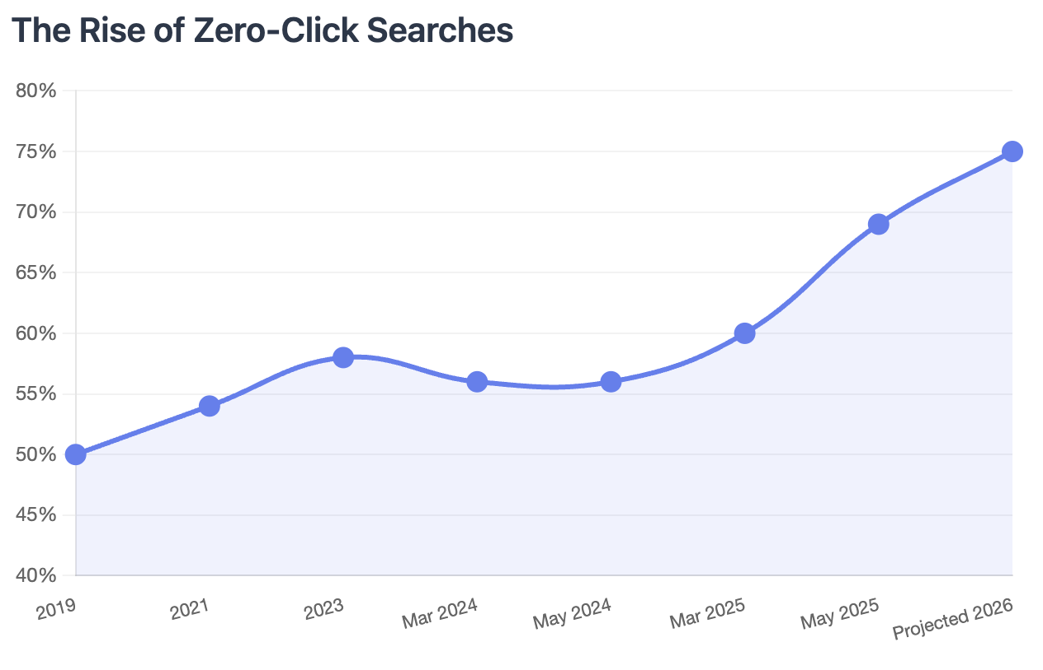
PEOPLE NO LONGER SEARCH, THEY ASK
HOW AI IS RESHAPING SEARCH STRATEGY
From Keywords to Conversations
Percentage of Google Zero-Click Searches
The Rise of Zero-Clicks Searches:
When AI Overviews appear in search results, 58% result in zero clicks.
In 2026, it’s expected to reach 75%.
Search Engine Land
Notes:
https://searchengineland.com/guide/what-is-ai-seo
This is the notable source^^^^
https://ahrefs.com/blog/ai-overviews-reduce-clicks-update/
https://www.seerinteractive.com/insights/aio-impact-on-google-ctr-september-2025-update
Sources: https://mikekhorev.com/ai-seo-trends https://www.conductor.com/academy/seo-content-predictions/
https://searchengineland.com/how-ai-is-reshaping-seo-challenges-opportunities-and-brand-strategies-for-2025-456926

Slide 9
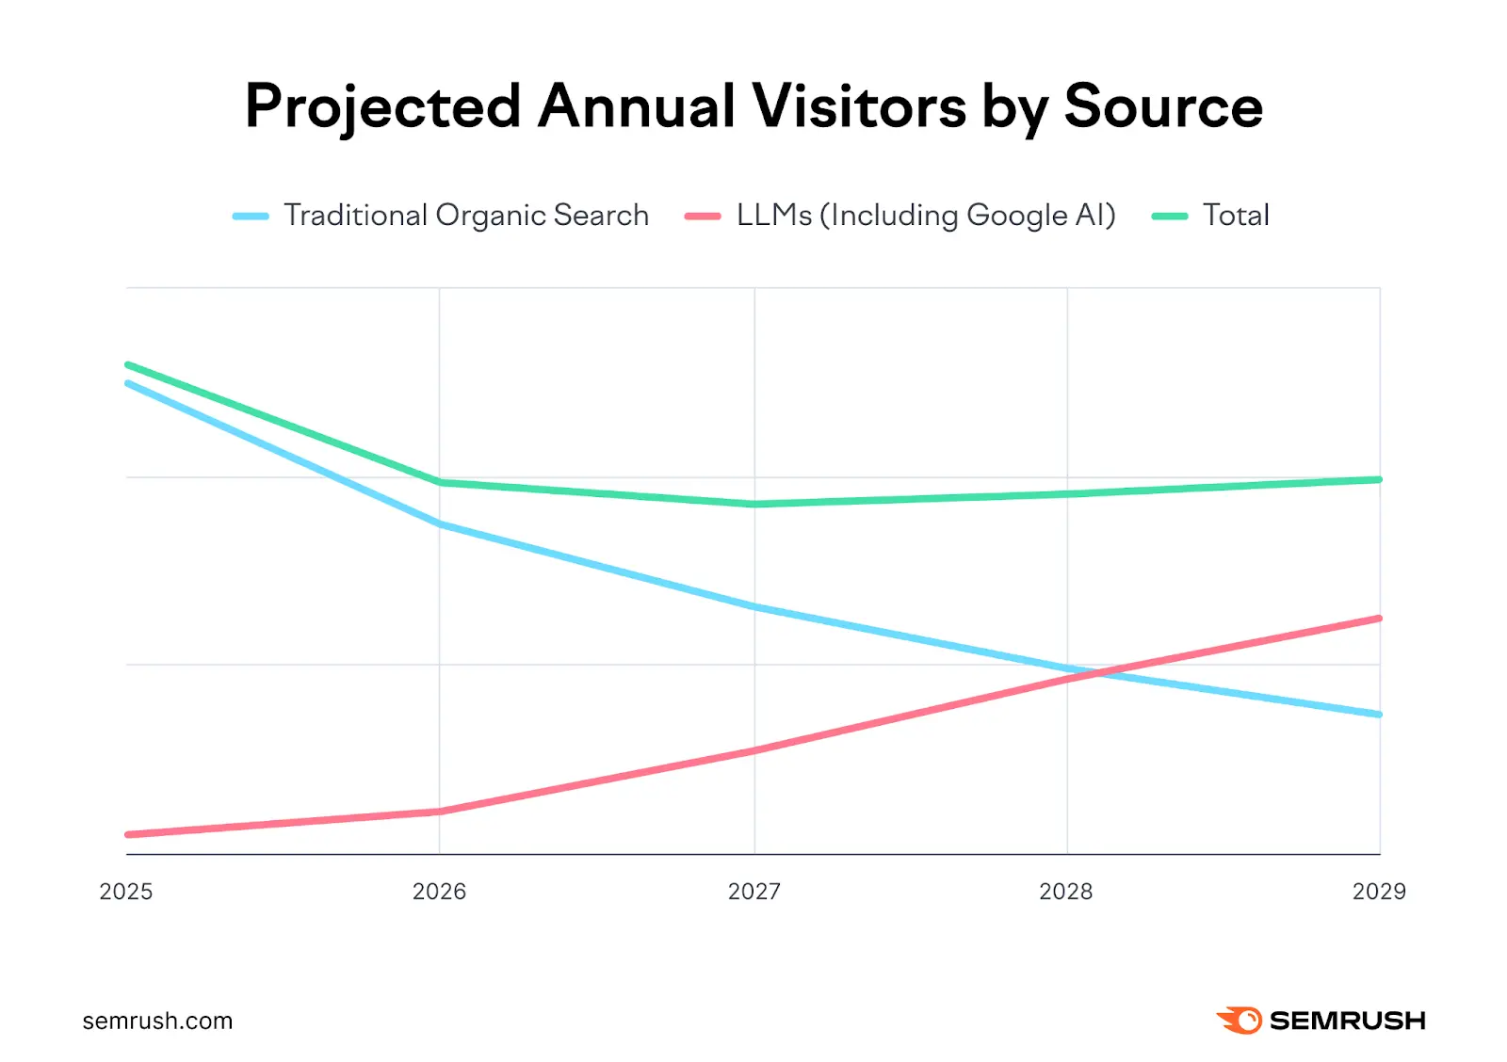
AI SEARCH ADOPTION + TRAFFIC SHIFT
HOW AI IS RESHAPING SEARCH STRATEGY
The Velocity of Change
By 2028, LLM search traffic is projected to surpass traditional organic search
ChatGPT now has 900M+ weekly active users (growing 9x from 100M in November 2023 to over 900M by December 2025)
AI platforms only represent 3% of search engine traffic currently, but we're in a paradigm shift of consumer search behavior
SemRush | CNBC | Seeking Alpha |
Notes:
clients are already feeling this shift in their organic traffic
Sources: First statistic:
https://www.semrush.com/blog/ai-search-seo-traffic-study/
Second stat:
https://sherwood.news/tech/chatgpt-reaches-nearly-900-million-weekly-active-users/
https://seekingalpha.com/news/4529731-chatgpt-reaches-900m-weekly-active-users-but-gemini-adoption-continues-to-heat-up-report
https://www.cnbc.com/2026/02/20/openai-resets-spend-expectations-targets-around-600-billion-by-2030.html#:~:text=In%20addition%20to%20Nvidia%2C%20strategic,Squawk%20Box%20Europe
https://www.semrush.com/blog/semrush-ai-overviews-study/
https://www.semrush.com/blog/how-to-rank-in-ai-search/
https://www.semrush.com/blog/ai-search-seo-traffic-study/

Slide 10
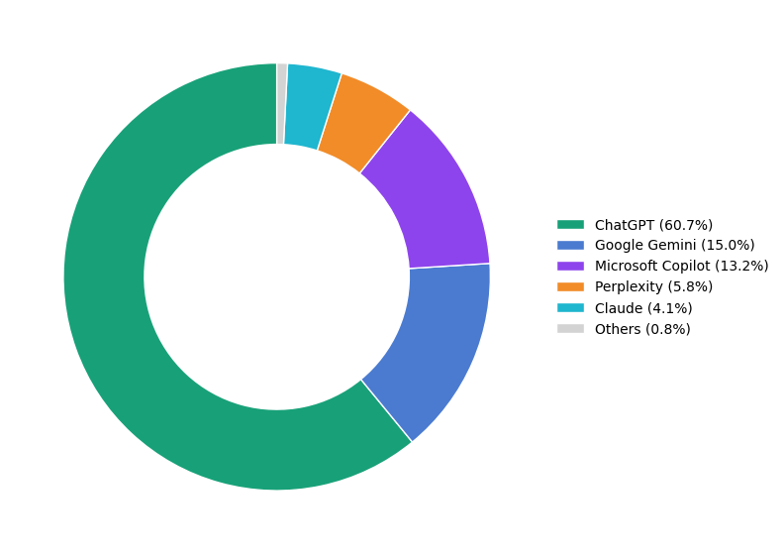
FROM KEYWORDS TO CONVERSATIONS
HOW AI IS RESHAPING SEARCH STRATEGY
The New Search Ecosystem
SEO (Search Engine Optimization)
‘Traditional Search’ based upon keyword ranking.
Still relevant, but declining influence. Much of the foundational practices still apply.
GEO (Generative Engine Optimization)
Deals with brand visibility ‘inside’ generative-AI responses, not on keyword rank performance.
ChatGPT, Perplexity, Claude, Gemini, etc. Separate website or app.
The lines begin to blur with Google AI Overviews/Mode & Gemini
As of February 2026, ChatGPT Owns over 60% of the AI Model Market Share
First Page Sage
Notes:
SEO is no longer just about ranking highly; it's about appearing in AI-generated answers
Source: https://firstpagesage.com/reports/top-generative-ai-chatbots/ https://www.helloroketto.com/articles/future-of-seo
https://www.concordusa.com/blog/the-evolution-of-search-in-2025-what-ai-means-for-seo

Slide 11
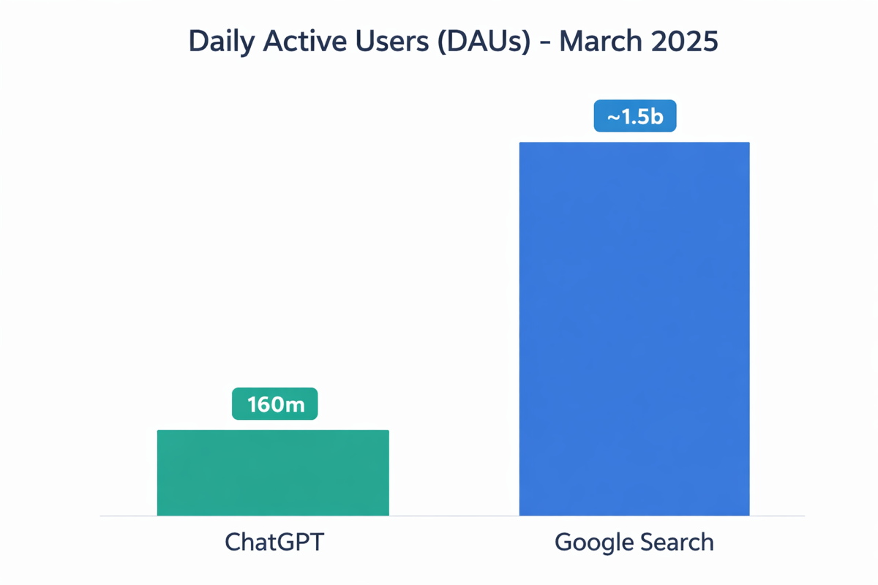
GOOGLE'S PATH TO AI DOMINANCE
HOW AI IS RESHAPING SEARCH STRATEGY
The Distribution Advantage
Active user dominance — 8.5B+ Google searches/day; AI Overviews supplement existing search behavior
No behavior change — AI appears inside familiar Google Search
AI Overviews reach — Now appearing in an estimated 20–30% of U.S. desktop queries
Ecosystem lock-in — Chrome, Android, Gmail, Workspace create constant touchpoints
Infrastructure + data — Decades of search data + massive AI training stack
~10X
Google DAUs over ChatGPT DAUs
Business Insider
Notes:
Source: https://www.businessinsider.com/chatgpt-crushing-google-ai-unless-you-look-data-differently-2025-4
https://archive.is/wuycm

Slide 12
WHY IT MATTERS

Slide 13
ZERO-CLICK IMPACTS BUSINESS
HOW AI IS RESHAPING SEARCH STRATEGY
Implications for Clients and Our Work
ORGANIC SEARCH
Channels that have reliably driven conversion are now being disrupted by zero-click behavior — reducing both traffic and downstream pipeline
When AI Overview is present & not cited, organic click-through rate dropped 65.2% YoY.
-65.2%
PAID SEARCH
When AI Overview is present & not cited, paid click-through rate dropped 78.4% YoY.
-78.4%
Seer Interactive
Notes:
Page Sources:
https://www.seerinteractive.com/insights/aio-impact-on-google-ctr-september-2025-update
Organic Search: With AIO present and not cited, organic CTR is 0.52% and down 65.2% YoY (Q3 2025 YoY).
Paid Search: With AIO present and not cited, paid CTR is 4.14% and down 78.4% YoY (Q3 2025 YoY).

Slide 14
SEARCH BEHAVIOR ACROSS VERTICALS
Adobe 1
Adobe 2
HOW AI IS RESHAPING SEARCH STRATEGY
B2C
B2B
60% of U.S. adults use AI to search for information;
74% for adults under 30 use AI search
Nearly 25% of B2B buyers use generative AI more often than traditional search
60%
25%
Travel
Corp Comms
77% of journalists use AI tools in their work, with 42% using ChatGPT
of travelers have used AI to find or book accommodations
86%
77%
AP | Digital Commerce 360 | PR News | Muck Rack
Notes:
B2C source
https://www.ap.org/news-highlights/spotlights/2025/how-us-adults-are-using-ai-according-to-ap-norc-polling/
B2B source:
https://www.digitalcommerce360.com/2025/10/15/generative-ai-traditional-search-b2b-vendor-discovery/
Travel source https://www.prnewswire.com/news-releases/takeups-the-rise-of-ai-planned-travel-in-2026-report-reveals-ai-is-reshaping-consumer-travel-but-with-room-for-growth-302660388.html
Corp Comms:
https://muckrack.com/blog/how-journalists-feel-about-ai?utm_source=chatgpt.com

Slide 15
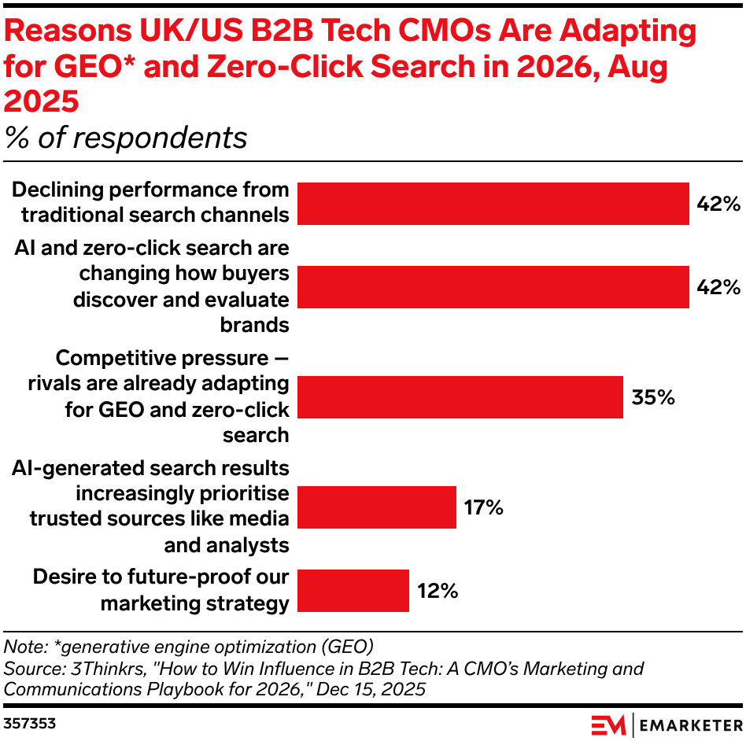
B2B CMOs ADOPTING GEO
HOW AI IS RESHAPING SEARCH STRATEGY
Responding to Zero-Click
Top reasons for adopting GEO (tied at 42%):
Declining SEO performance
Changing buying behavior
94% of CMOs plan to increase investment in GEO in 2026
EMARKETER
Notes:
https://www.emarketer.com/content/b2b-tech-cmos-say-traditional-search-already-failing-them (from Stephanie Estes)

Slide 16
WHAT IT MEANS

Slide 17
NEW PLAYBOOK FOR BRAND VISIBILITY
HOW AI IS RESHAPING SEARCH STRATEGY
OWNED
AI models do not see marketing silos. They use the total digital footprint to assemble and synthesize their answer.
Website
Blog
I HAVE A QUESTION
EARNED
LET ME GET THE ANSWER
Media Coverage
Influencers
SHARED
Ratings & Reviews
User-Generated Content
Social
PAID
Paid AI Placement (New)
Media Partnerships

Slide 18
OWNED: THE TRUTH ANCHOR
HOW AI IS RESHAPING SEARCH STRATEGY
Websites are not going away — they are transforming
+4.4X
Trust Anchor: Verification point for AI-generated information
Data Source: Training ground for AI systems
Conversion Hub: Website remains pivotal for conversion points and bottom funnel content (case studies, pricing, etc.)
On average, visitors referred by AI search convert at 4.4x the rate from traditional organic search
SemRush
Notes:
4.4X Sources:
https://www.semrush.com/blog/ai-search-seo-traffic-study/
https://www.conductor.com/academy/seo-content-predictions/

Slide 19

OWNED: WHAT MATTERS
HOW AI IS RESHAPING SEARCH STRATEGY
Establish owned content as the definitive source
Ensure that your brand’s core entity data — names, products, leadership, positioning, value propositions — is clearly articulated, consistent, and prominent.
Structure content for extractability
AI systems pull from self-contained passages. Structure content so that individual paragraphs can stand alone as citable answers.
Implement structured data
Help AI systems understand and correctly attribute your content with structured data, semantic HTML5 markup, FAQ schema, and consistent entity information.
Retain the Conversion Hub
As AI summaries have taken over the role of much of the higher funnel functions, lower funnel functions of deeper evaluation and conversion execution remain with the website.

Slide 20
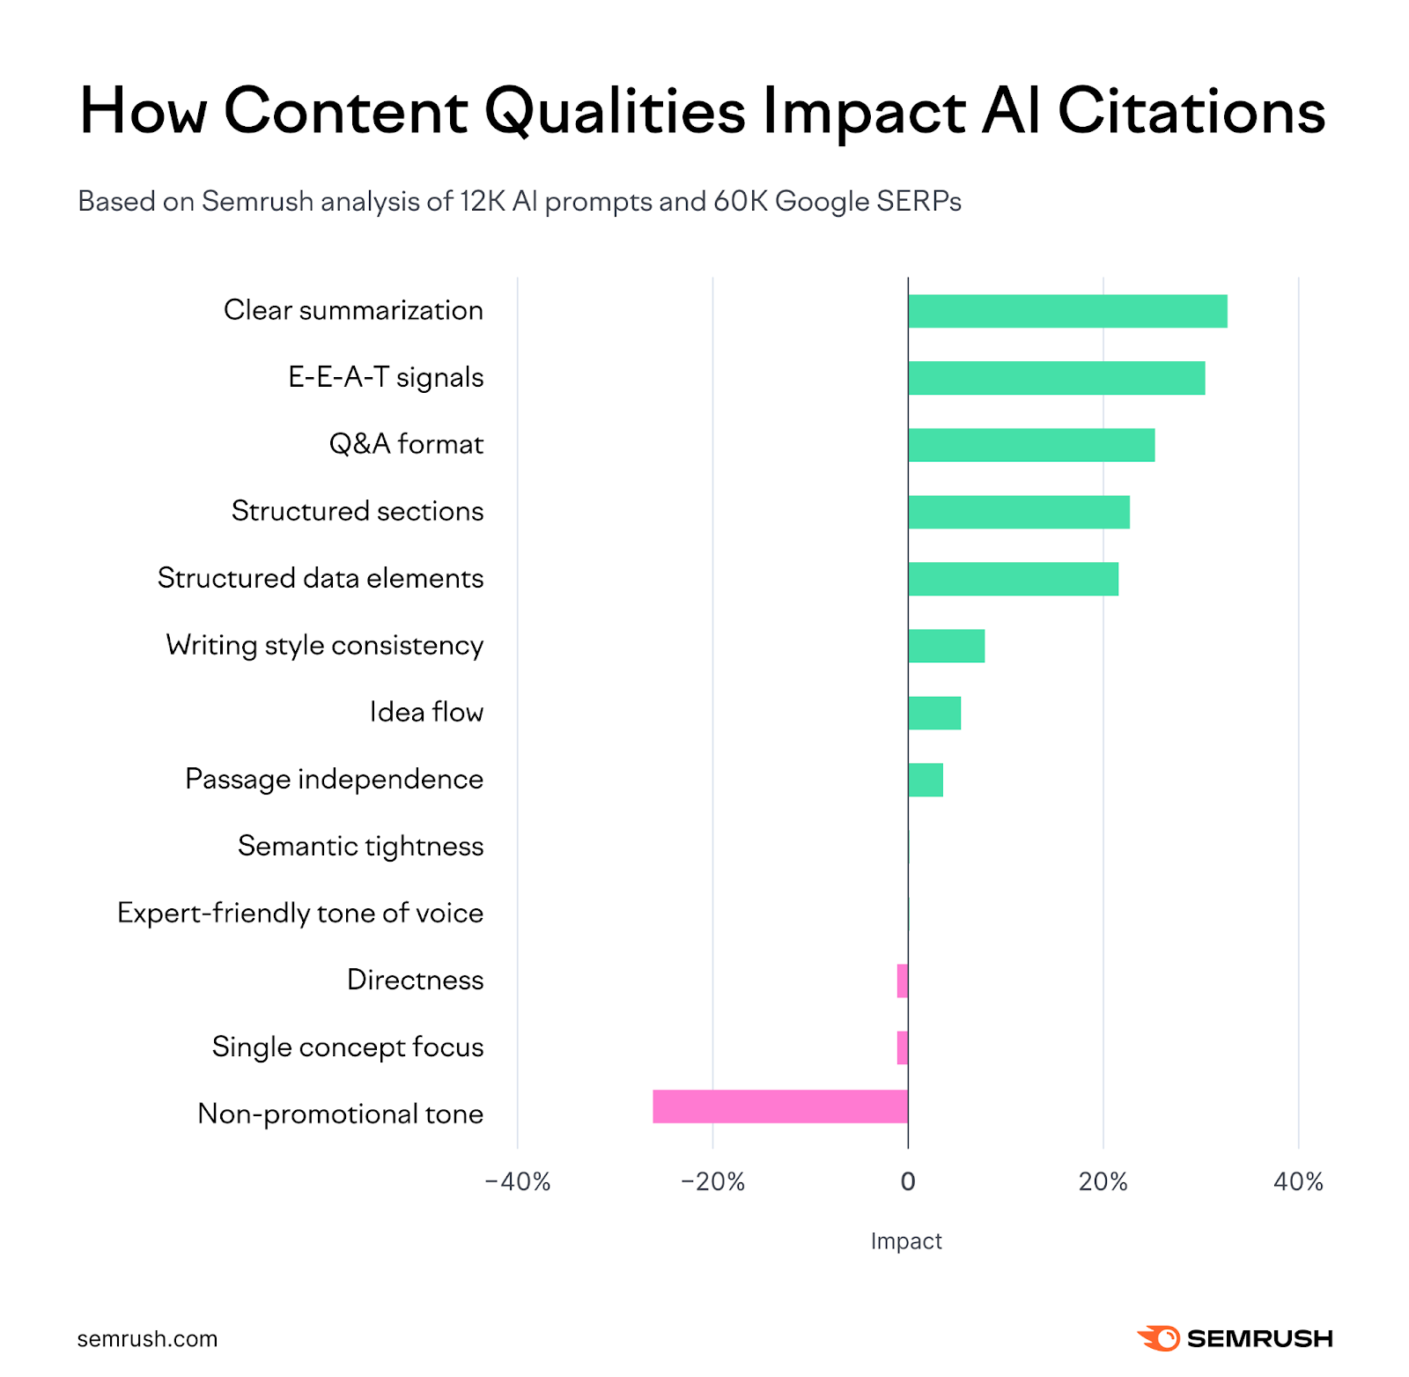
OWNED: WHAT MATTERS
HOW AI IS RESHAPING SEARCH STRATEGY
5 Website Content Qualities that Influence AI Citations:
Clarity and Summarization: +32.83%
E-E-A-T Signals: +30.64%
Q&A format: +25.45%
Section Structure: +22.91%
Structured Data Elements: +21.60%
Experience, Expertise, Authoritativeness, Trustworthiness (E-E-A-T) is a Google framework to explain how its search engine evaluates content.
SemRush
Notes:
Owned stats:
https://www.semrush.com/blog/content-optimization-ai-search-study/

Slide 21
EARNED: SIGNALS OF TRUST
HOW AI IS RESHAPING SEARCH STRATEGY
Earned placements — mentions, quotes, interviews, and citations — are not just reaching people, they’re training the machines
61%
of brand reputation signals originate from editorial media
Authoritative signals are used as the mechanism for which AI determines whether a brand’s claims are credible.
Ad Age reports that AI favors trusted, editorially earned media when delivering information.
Media mentions across trusted publications, schema-enriched pages, first-party research, and expert quotes are what AI systems rely on
Earned media provides unbiased endorsements that Google values highly when compiling search results
Ad Age | Hard Numbers
Notes:
Ad Age
https://adage.com/opinion/aa-how-ai-has-collapsed-the-funnel-and-elevated-earned
61%
https://www.hardnumbers.co.uk/research-reputation-in-the-age-of-ai

Slide 22

EARNED: WHAT MATTERS
HOW AI IS RESHAPING SEARCH STRATEGY
Position experts as quotable sources
AI surfaces expert quotes from trusted publications. Commentary should be clear, educational, and standalone — no sales language or buzzwords.
Maintain narrative consistency
When your brand steadily appears in the same contextual topics, AI learns to associate you with those attributes. Inconsistent messaging creates conflicting signals, eroding trust.
Target top-tier and niche trade publications
AI prioritizes contextual depth over volume. Niche outlets can be as powerful as national ones.
Media mentions across trusted publications, schema-enriched pages, first-party research, and expert quotes are what AI systems rely on
Earned media provides unbiased endorsements that Google values highly when compiling search results
Notes:
Ad Age
https://adage.com/opinion/aa-how-ai-has-collapsed-the-funnel-and-elevated-earned
61%
https://www.hardnumbers.co.uk/research-reputation-in-the-age-of-ai

Slide 23
SHARED: COMMUNITY PROOF
HOW AI IS RESHAPING SEARCH STRATEGY
AI prioritizes authentic, conversational content that reflects real-world user experience
Most-cited domains across all major AI platforms
Reddit (40.1%)
Wikipedia (26.3%)
YouTube (23.5%)
Consumer-generated content reflects sentiment with relative neutrality seeking authentic evaluation — both positive and negative — to form answers.
For some industries and question-types, AI Search has elevated Consumer Generated Content and review platforms from supplemental to integral.
Discovered Labs
Notes:
Most cited domains: https://discoveredlabs.com/blog/reddit-as-an-aeo-signal-source-how-llms-pull-brand-mentions-to-drive-ai-citations

Slide 24

SHARED: WHAT MATTERS
HOW AI IS RESHAPING SEARCH STRATEGY
Authentic community engagement
Genuine, sustained participation — answering questions, sharing expertise and contributing. AI can detect and prioritize content that feels promotional or manufactured. One-off campaigns don’t build lasting citation authority.
Monitor and manage brand sentiment actively
Unaddressed criticism shapes how AI represents your brand. Respond transparently and constructively — AI cites these interactions alongside positive mentions.
Encourage substantive reviews on key review platforms
Ensure your brand has a strong presence on review platforms that AI systems trust including industry-specific sites. Encourage detailed, experience-based reviews from customers rather than generic star ratings, as AI favors substantive, multi-sentence content.

Slide 25
PAID: THE AMPLIFIER
HOW AI IS RESHAPING SEARCH STRATEGY
While AI summaries directly surface paid ads, paid media drives awareness that amplifies behavior across channels that AI leverages
91% higher CTR
Paid CTR (Click-through Rate) dropped 68% for queries with AI Overviews. However, brands cited in AI Overviews see 91% higher paid CTR compared to non-cited brands.
While the channel is shifting, PPC opportunities remain for lower-funnel terms where AI summaries do not adequately cover the intent of the consumer.
Paid opportunities within the AI search space are emerging with the news from ChatGPT, as well as others that are certain to be on the horizon.
Seer Interactive
Notes:
https://www.seerinteractive.com/insights/aio-impact-on-google-ctr-september-2025-update

Slide 26

PAID: WHAT MATTERS
HOW AI IS RESHAPING SEARCH STRATEGY
Paid Search remains relevant.
Informational queries are increasingly satisfied by AI Overviews. Optimize for conversions, not clicks — the upper-funnel click pool has shrunk.
Use paid to fuel AI-visible brand authority.
Think of paid not just as direct response but as an amplifier of the signals AI uses to decide which brands to recommend. Branded search volume drives citation frequency.
Prepare for AI-native ad formats.
Google’s rollout of ads within AI Overviews and AI Mode is the next frontier. Ensure campaigns leverage Performance Max and Shopping formats eligible for these placements.

Slide 27

WHAT DOES AI VALUE?
HOW AI IS RESHAPING SEARCH STRATEGY
Factors that affect responses:
AI Models
Question-type
Industry
Core Top-Level GEO Strategies:
Authority Building — Citations and mentions across authoritative sources
Originality — First-party research and unique insights
Consistency — Messaging alignment across channels
Structured Data — Schema markup and clear formatting

Slide 28
INTEGRATED STRATEGY WINS
HOW AI IS RESHAPING SEARCH STRATEGY
AI Visibility Relies on the Health of the Whole
OWNED
Truth Anchor
EARNED
Signals of Trust
SHARED
Community Proof
PAID
The Amplifier
It’s the health of the whole — the coordinated strength across all four channels — that determines whether a brand surfaces in AI-generated answers or is overlooked.

Slide 29
WHAT TO DO

Slide 30
“AI VISIBILITY” — WHAT IS IT?
HOW AI IS RESHAPING SEARCH STRATEGY
Based on answering a seemingly simple core question:
How is our brand showing up in AI answers to customer questions?
Followed by a series of questions with not-so-simple answers:
If it’s appearing, what's it saying?
What websites is it citing? (hopefully, ours)
If not us, who is mentioned? What is cited?
How can we make an impact?
Where do we begin?

Slide 31
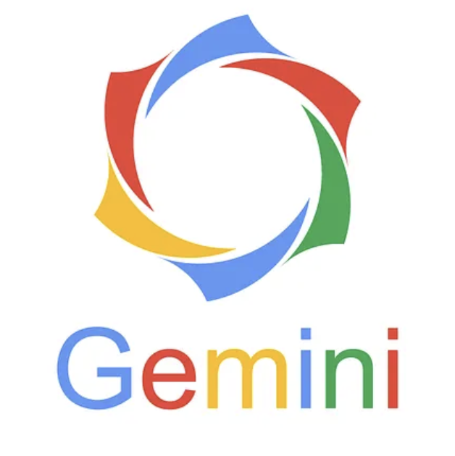
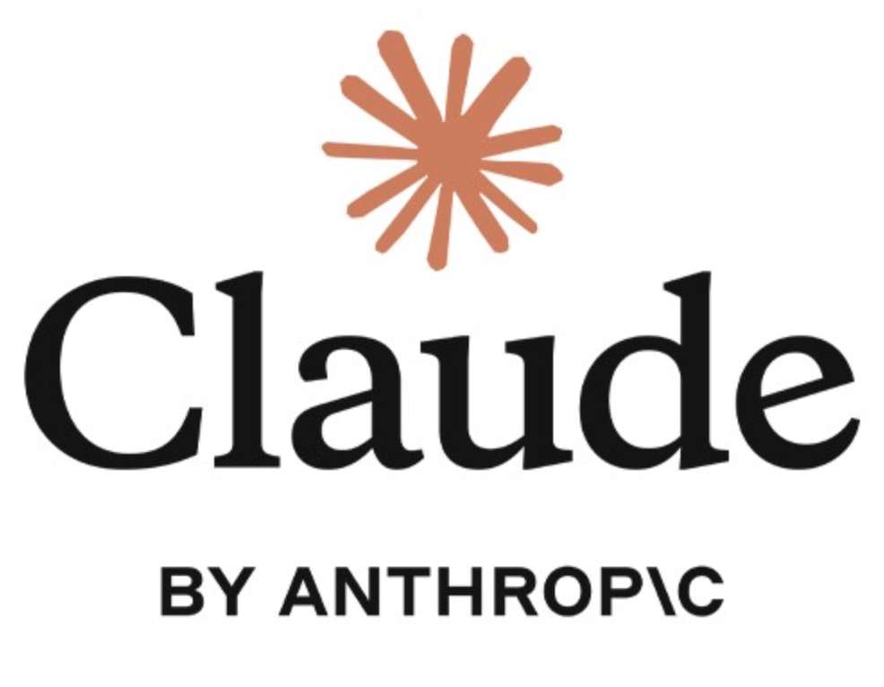
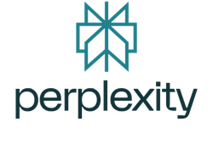

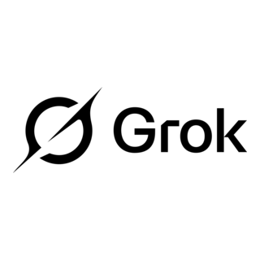
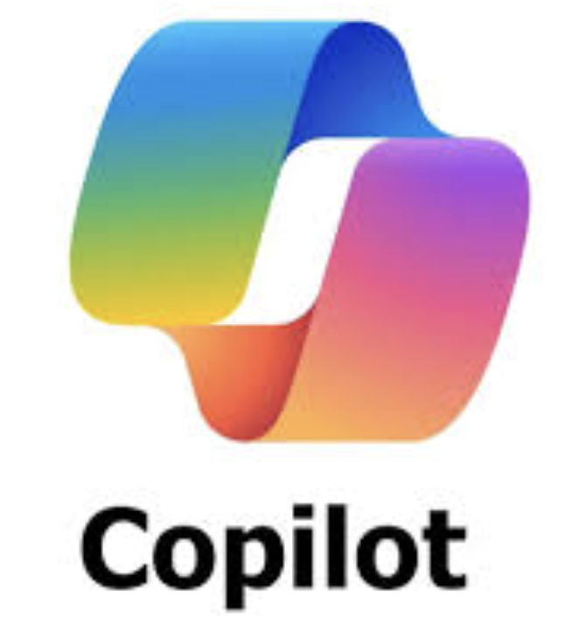
WHERE TO START: AI VISIBILITY AUDIT
Comprehensive Audit
Reveals how your brand appears in AI-generated responses to customer questions
AI Models
Customized
(Not off-the-shelf generalizations)
The Shipyard’s AI Visibility Audit Covers:
Presence: How and where your brand appears across high-intent audience questions
Narrative: What AI says about your brand and the tone and accuracy of coverage
Source: Which sources AI references — and whether/when your site is included
Competitive Context: How your visibility compares to other sites
Nuanced Industry
Specific Customers
Defined Competitors

Slide 32
MEASURABILITY GAP: WHY GEO REQUIRES A DIFFERENT METHOD THAN SEO
EXAMPLE GEO AUDIT METHODOLOGY
SEO is like quantitative survey research
GEO auditing is closer to qualitative research
Based upon data that Google provides.
Defined variables and repeatable measurement deliver stable, comparable results.
Audits rely on preset parameters — keywords, rankings, and volume.
Insights are typically standardized, aggregate performance metrics.
LLMs do not make data available.
Open-ended inputs create higher variance outputs that require interpretation.
Results shift with phrasing, intent, context, and user need — so the way we structure questions directly influences what we observe.
Insights are not always reducible to standardized metrics requiring deeper analysis for meaning.
Notes:
Mike (Scott as backup)

Slide 33
TAILORING FOR NUANCES:
EXAMPLE GEO AUDIT METHODOLOGY
Full-Funnel Approach to Question Design
1. Alignment:
Defined priority audiences and what core types of insights we’re looking to find.
Is there anything specifically we're trying to uncover?
2. Question Design:
Building a structured universe on how our audiences seek answers across the full customer journey.
What questions do your customers ask that you want to show up for?
Unaided Questions
Centered around the customers’
challenges or tasks
(no brand mention)
Aided Questions
When customers are asking
by brand name
Notes:
Mike (Scott as backup)

Slide 34
OUTPUT: AI VISIBILITY AUDIT
What it provides:
INSIGHTS:
Answers the question: How is the brand showing up in AI-generated responses to customer questions
LAUNCH PAD FOR:
Content Ideas: Better understanding where content may need bolstered.
Channel Insights: What is it that AI is citing most? Where should we play?
Website Updates: Technical and content enhancements to improve AI crawlability.
Outline:
Audit Summary
Strengths, Gaps, Opportunities
Citation Analysis:
Top Website Citations
Channel Performance
AI Model Performance
Brand Site Performance
AI Response Analysis:
Narrative Overview
Key Themes
Competitive Landscape
Core Takeaways

Slide 35
OUR EXPERIENCE
HOW AI IS RESHAPING SEARCH STRATEGY
COMPLETED
UP NEXT
PITCHED
Garden Weasel
B2C (Garden Tools)
Website vs. retailers?
Ohio’s 529 Savings Plan
B2C (College savings fund)
Concerned about misinformation
Copeland
Swisslog
ANSWER
Creative Composites Group
B2B (Industrial Fiber-Reinforced Polymer)
5 brands, 5 customer segments, 1 site – How does that affect AI search?
UNDERWAY
Bath & Body Works
Corporate Comms
What are journalists looking for and using when they cover BBW?

Slide 36
CASE STUDY:
GARDEN WEASEL

Slide 37

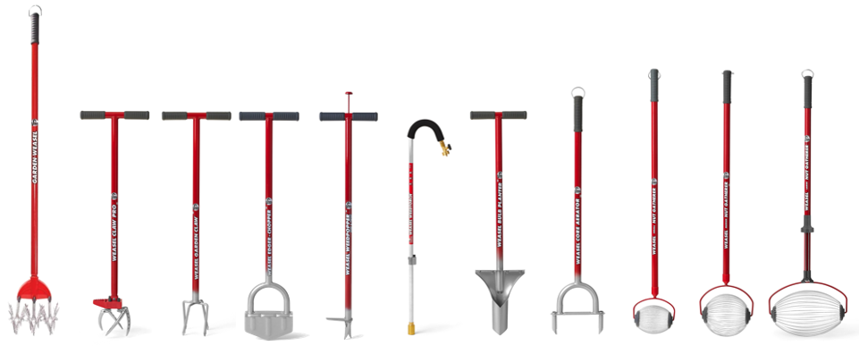
CASE EXAMPLE: GARDEN WEASEL
HOW AI IS RESHAPING SEARCH STRATEGY
The Situation
Garden Weasel is a 40+ year garden tool brand known for ergonomic, stand-up gardening tools
How does our brand site perform against Amazon and retailers in AI responses?
The Approach
50 journey-based prompts:
Unaided: problem-solving queries with no brand mention (e.g., ‘What’s the easiest way to aerate lawn by hand?’)
Aided: brand-included queries reflecting consideration and purchase intent (e.g., “Are garden weasel tools worth the money?”)
5 AI Models:
ChatGPT, Google AI Overview, Google AI Mode, Perplexity, Gemini
5 Competitors:
Fiskars, Corona, Yard Butler, Bully Tools, Gardena
ANSWER

Slide 38
WHAT WE LEARED: WHERE THEY SHOW UP & HOW THEY’RE PERCEIVED
HOW AI IS RESHAPING SEARCH STRATEGY
VISIBILITY
Strong position, but narrow footprint
Position: Garden Weasel ranked #2 in unaided brand mentions, just behind Fiskars.
Narrow Product Mentions: Visibility concentrated almost entirely in nut and debris collection queries — while Fiskars appeared across ergonomics, edging, weed removal, and general tool recommendations.
The Rotary Cultivator — a flagship product — did not appear in a single unaided AI response.
Fiskars and Corona dominated arthritis-friendly and standing-tool queries despite Garden Weasel having directly relevant products.
New Competitor: Bag-a-Nut, not in the original competitor set, emerged as a strong competitor in the same nut-gathering space.
SENTIMENT
The foundation is strong — protect it
Positive: When AI platforms organically recommend Garden Weasel, sentiment is unanimously positive.
Limited Negative: Only 9% of aided responses carried negative sentiment — all prompt-driven (users specifically asking about complaints or breakage).
Strengths: AI consistently positions Garden Weasel around ergonomic/back-saving design, durable construction, and lifetime warranty.
Weaknesses: AI surfaces are specific and actionable: hard/clay soil performance, tine durability under stress, and plastic component concerns.
Opportunities: Address objections proactively before AI defaults to third-party narratives.
ANSWER

Slide 39
HOW AI IS RESHAPING SEARCH STRATEGY
WHAT WE LEARED: HOW DOES AI WEIGH BRAND SITE VS. RETAILERS?
One of Garden Weasel’s core questions — the data tells a nuanced story
Unaided Questions
Centered around the customers'
problems or tasks
(no brand mention)
Unaided - Discovery Intent
Amazon and gardenweasel.com had nearly identical citation counts.
But, Amazon covered 25% of unaided prompts vs. only 10% for the brand site — Amazon’s product breadth carries it across more categories.
Social platforms (Reddit, YouTube, Facebook) dominated unaided citations overall, accounting for 13.4% of all citations combined.
AI doesn’t inherently favor one over the other – brand site or retailer.
User intent determines what sources AI selects.
Top-funnel:
Brand site & retailers equal in citations, however brand site is for only one product
Social carries weight
Mid-funnel:
Brand site prevails
Bottom-funnel:
Retailers own the purchase moment.
ANSWER
Aided Questions
When customers are asking
by brand name
Aided - Consideration Intent
Gardenweasel.com dominated decisively as the top cited domain.
Retailers (Home Depot, Amazon, Walmart, Lowe’s) collectively accounted for 14.3% of aided citations.
But, on the “where to buy” prompt specifically, Home Depot greatly overshadowed the brand site.

Slide 40
HOW TO ENGAGE

Slide 41
THE STARTING POINT
AI Visibility Audit — How to Engage Clients in This Work
Good Candidates for an Audit
Opportunity Checklist
“AI Search-curious” clients who have asked about it
“Feeling pains of zero click” clients experiencing traffic declines or unexpected shifts in site performance
“New content ideas” brands looking for new territories for content — topics or types of content
“New ways to reach audiences” clients looking for new channel approaches
“Planning stage” clients actively in annual or campaign planning mode
“New business” opportunities where a quick audit might yield thought-provoking insights for the pitch
Check if applies:
Customer uses AI for discovery
Seeing decline in website performance
Looking for opportunities and curious if GEO can help
It’s unknown how well the website is structured for AI crawlability
Desires to learn basics of GEO and what it might mean for business
If yes to 2+, then good candidate

Slide 42
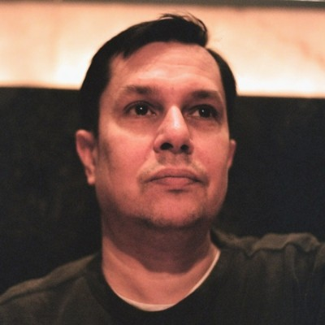


WHO TO CONTACT
HOW AI IS RESHAPING SEARCH STRATEGY
Sean Cowan EVP, Digital Experience scowan@theshipyard.com
Mike Klebacha AVP, Digital Strategy mklebacha@theshipyard.com
Katie Tebbutt VP, Director of Digital Project Management ktebbutt@theshipyard.com

Slide 43
AIO/GEO
DECEMBER 2025
CURRENT MECHANICS OF AIO/GEO

Slide 44
INSTAGRAM/META CITATIONS
CURRENT MECHANICS OF AIO/GEO
While META is accessible to Search & LLMs as of November 2025, not all LLMs use the data the same.
LLM / ASSISTANT | How it accesses Instagram / Meta data (high level) | Example B2B Research Use Case | How Likely is it to Explicitly Show / Cite an Instagram Post?
Google Gemini (incl. AI Overviews) | Uses Google's web index + Knowledge Graph. Since July 2025, public content from Instagram professional accounts is indexable, so IG posts can appear like any other result and can be pulled into AI Overviews. | Buyer searches: "examples of ESG dashboards from supply chain vendors." Gemini may summarize options and include tiles or links to relevant IG posts from vendor accounts that showcase dashboards. | Medium – Gemini will explicitly show IG posts when: (1) the query is visual/brand/creator-focused, (2) an IG post ranks highly, or (3) the user hints at Instagram ("show me Instagram posts about…"). For generic B2B queries, IG is more often one of many sources, not the main one.
ChatGPT with Search / Browse | Uses a search backend (currently Bing-powered in many regions) plus OpenAI's own ranking layer. It can follow and summarize any public IG URL that appears in web results. | User asks: "Compare Vendor A vs Vendor B's employer brand using social examples." ChatGPT might look at websites, LinkedIn, and surface or summarize a couple of IG posts if they show up in search. | Low–Medium – Most of the time, IG content is used in the background to shape the answer. You'll only see a direct instagram.com/... citation if: (a) you paste an IG URL, or (b) an IG page is an unusually strong match that ranks high for the query. Otherwise, it tends to quote blogs, docs, and Reddit/YouTube more.
Perplexity | Web-first "answer engine," heavily citation-driven, often using Bing's index. It can read and summarize IG post URLs like any other page. | Buyer: "Show me real-world examples of product-led onboarding flows in B2B SaaS." Perplexity might cite case studies and occasionally an IG carousel or Reel from a PLG-focused brand that walks through onboarding. | Medium (but niche-triggered) – Because Perplexity loves showing lots of sources, it will sometimes include IG links when: (1) posts are detailed and SEO'd, or (2) you explicitly mention Instagram or supply an IG URL. For most generic B2B questions, IG still plays a background role vs more text-heavy sources.
Claude (Anthropic) | Uses Brave Search as its web backend. Any public, indexable instagram.com pages can be seen and summarized. | Buyer: "Give me 3 smaller cybersecurity vendors with strong educational content on secure-by-design." If your IG feed is well-optimized and referenced on other sites, Claude can discover it and summarize some posts. | Low – Claude tends to lean on docs, blogs, news, and long-form content. It may "read" IG posts to inform its understanding, but it seldom surfaces IG as a front-and-center citation unless you give it the URL or explicitly ask it to "analyze this Instagram post."
Grok (xAI) | Has privileged, real-time access to X (Twitter) plus general web search. It can follow links from X to Instagram and read those pages. | Buyer: "What vendors are people on X talking about for AI-powered contract review? Include any visual explainer content." If analysts are sharing your IG Reels on X, Grok might follow those links and factor them into its summary. | Low – Grok's "star" social source is X. Instagram matters mostly indirectly (via links people share on X). It's unlikely to spontaneously show IG posts unless queries, or X links, point it there.
Meta AI (inside Instagram, Facebook, WhatsApp, Messenger + web) | First-party access to public Instagram and Facebook content from adults (used for training/tuning), plus the broader web. Embedded directly inside Meta apps as a chatbot and assistant. | User types in Instagram: "Show me B2B SaaS tools that help manufacturers reduce downtime" or "What's this vendor known for?" Meta AI can answer using both on-platform posts and external sites, heavily influenced by IG + FB content. | High influence, low explicit linking – Meta AI is steeped in IG/FB data, but inside the apps it usually answers conversationally rather than saying "Here's this specific IG post." Think of your IG content as strongly shaping its intuition and examples, but not always showing as clickable links. When you ask "show me posts from…", it will surface specific accounts and content more directly.
Notes:
Scott

Slide 45
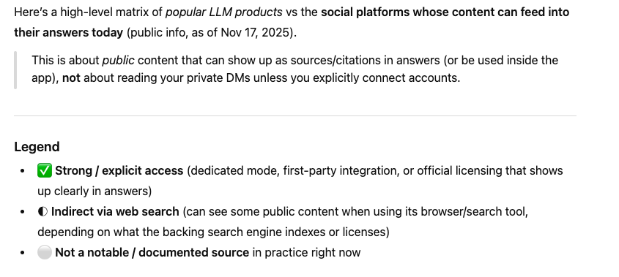
SOCIAL MEDIA CITATIONS
CURRENT MECHANICS OF AIO/GEO
While it's accessible to Search & LLMs, not all LLMs use the data the same.
LLM PRODUCT | REDDIT | X / TWITTER | FACEBOOK | INSTAGRAM | YOUTUBE | TIKTOK | LINKEDIN
OpenAI ChatGPT (with Search/browsing) | ✓ Licensed + frequently cited | ◐ via web search (when public pages reachable) | ◐ via web search | ◐ via web search | ◐ via web search (esp. transcripts & docs) | ◐ via web search (less commonly cited) | ✓ appears among top cited domains in some studies
Google Gemini (AI Overviews / AI Mode) | ✓ heavily cited + licensed; integrated into Reddit Answers | ◐ via Google Search | ◐ via Google Search | ◐ via Google Search | ✓ very strong (Google-owned; top-cited in AI Overviews) | ◐ via Google Search | ✓ frequently cited (esp. in B2B topics)
Microsoft Copilot (Bing / Copilot Search) | ◌ New Reddit content largely missing since Bing blocked in 2024 | ◐ via Bing | ◐ via Bing | ◐ via Bing | ◐ via Bing | ◐ via Bing | ◐ via Bing (plus internal MS ecosystem)
Anthropic Claude (with Web Search) | ◐ via Brave Search (Reddit often shows up in citations) | ◐ via Brave Search (public X content) | ◐ via Brave Search | ◐ via Brave Search | ◐ via Brave Search (videos/transcripts) | ◐ via Brave Search | ◐ via Brave Search
Perplexity AI (Search + "Social" focus) | ✓ Strong: Social mode explicitly searches Reddit | ✓ Strong in Social mode: searches Reddit, X, and other social platforms | ◐ via general search | ◐ via general search | ✓ very strong (YouTube is a top source) | ◐ via general search (often surfaces TikTok when relevant) | ✓ LinkedIn shows up frequently for professional topics
Meta AI (Facebook, Instagram, WhatsApp) | ◐ via web search | ◐ via web search | ✓ First-party integration; uses public posts for training | ✓ First-party integration (same as Facebook) | ◐ via web search | ◐ via web search | ◐ via web search
xAI Grok (on X & grok.com) | ◐ via web search backend | ✓ Deep, real-time access to public X posts is a core feature | ◐ via web search | ◐ via web search | ◐ via web search | ◐ via web search | ◐ via web search
Legend: ✓ = Strong/Direct access | ◐ = Indirect via search | ◌ = Limited/Blocked
Notes:
Scott

Slide 46
SOCIAL MEDIA CITATIONS
CURRENT MECHANICS OF AIO/GEO
While it's accessible to Search & LLMs, not all LLMs use the data the same.
LLM PRODUCT | HOW IT GETS SOCIAL CONTENT
OpenAI ChatGPT | Uses OpenAI's Search stack (Bing-powered) and licensed sources; third-party analyses show Reddit, Wikipedia, YouTube, LinkedIn, etc. are common cited sources, with Reddit especially prominent recently. NEW: Also has direct publisher partnerships with Condé Nast, Financial Times, AP, Reuters, and others for premium content.
Google Gemini | Uses Google's index; AI Overviews & AI Mode pull from the usual web mix, but studies show a strong bias toward YouTube, Reddit, LinkedIn, Wikipedia.
Microsoft Copilot | Builds answers on top of Bing search. Since Reddit blocked Bing, fresh Reddit posts don't typically appear; other public social sites can show up if Bing indexes them.
Anthropic Claude | Web search launched March 20, 2025, using Brave Search as backend, pulling from whatever Brave has indexed; external analyses show Reddit, YouTube, Wikipedia and official sites as common domains, with Claude somewhat more academic/government-heavy than competitors.
Perplexity AI | Basically an AI web/search engine; its Social focus is one of the few explicit "social search" modes in LLM land, prioritizing Reddit, X, and other social discussions.
Meta AI | Embedded in Meta's apps; can use public Facebook/Instagram content plus your interactions to train and personalize. Private messages excluded from training.
xAI Grok | Tightly integrated with X: can read real-time public posts and also perform general web search, so conversations heavily lean on X content plus broader web. NEW: Became free for all X users on December 6, 2024 (previously Premium+ only).
Notes:
Scott

